Slide 1


Slide 2

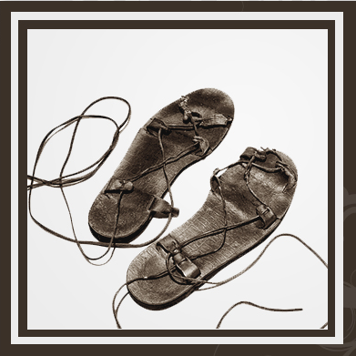



Psalm 84:5
⁵ Blessed is the man whose strength is in You,
Whose heart is set on pilgrimage. (NKJV)

Slide 3
The Pilgrimage

Slide 4
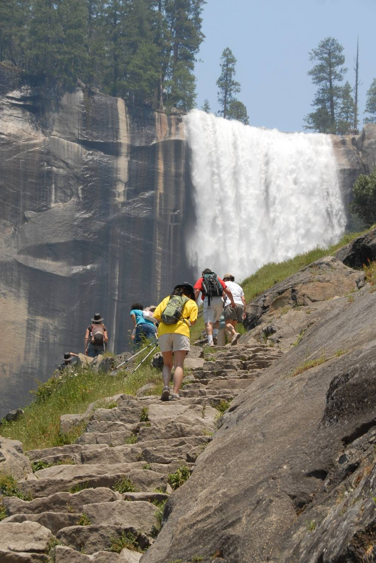

Slide 5
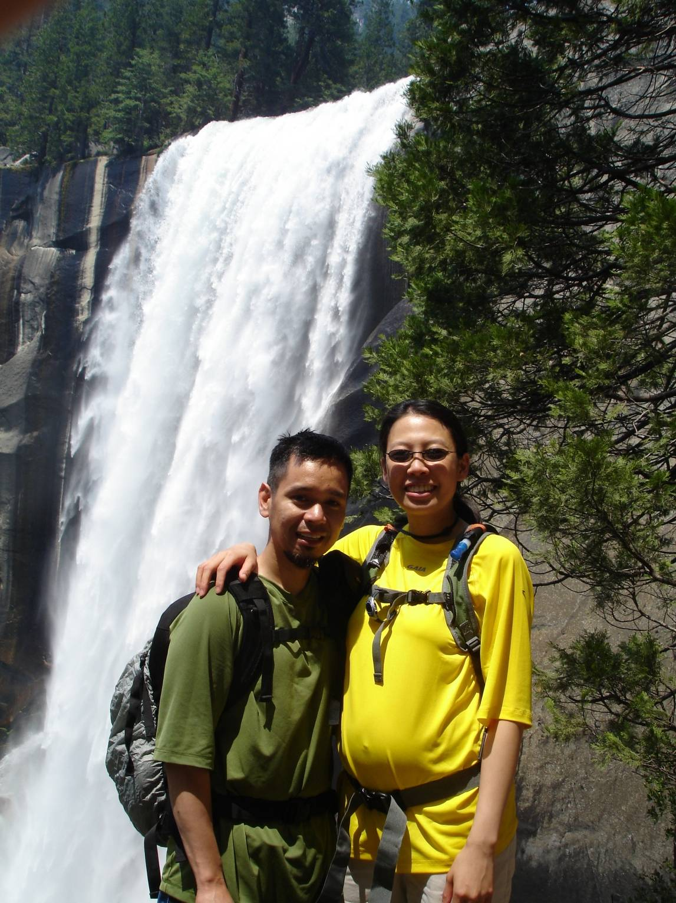

Slide 6
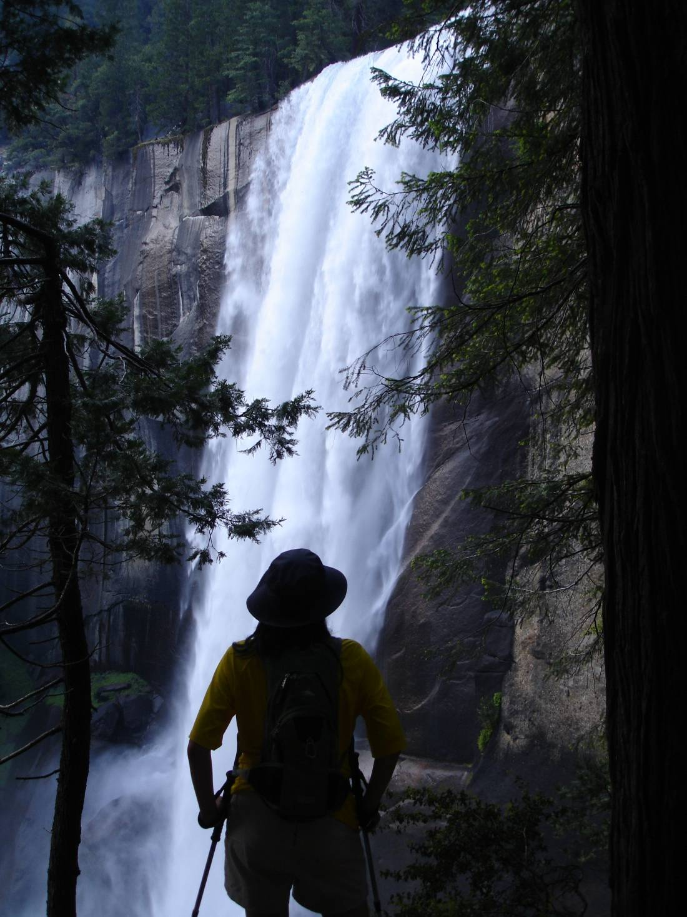

Slide 7
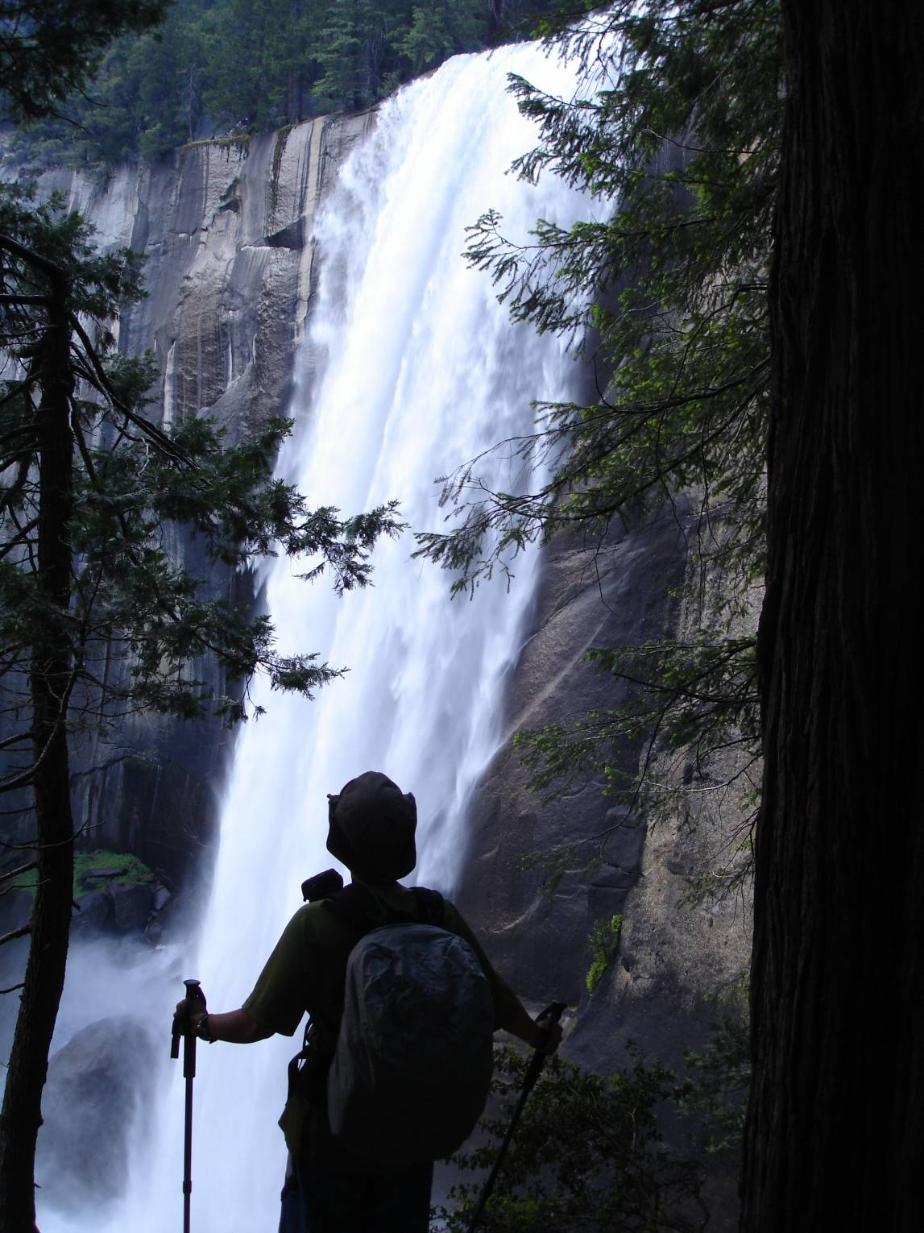

Slide 8
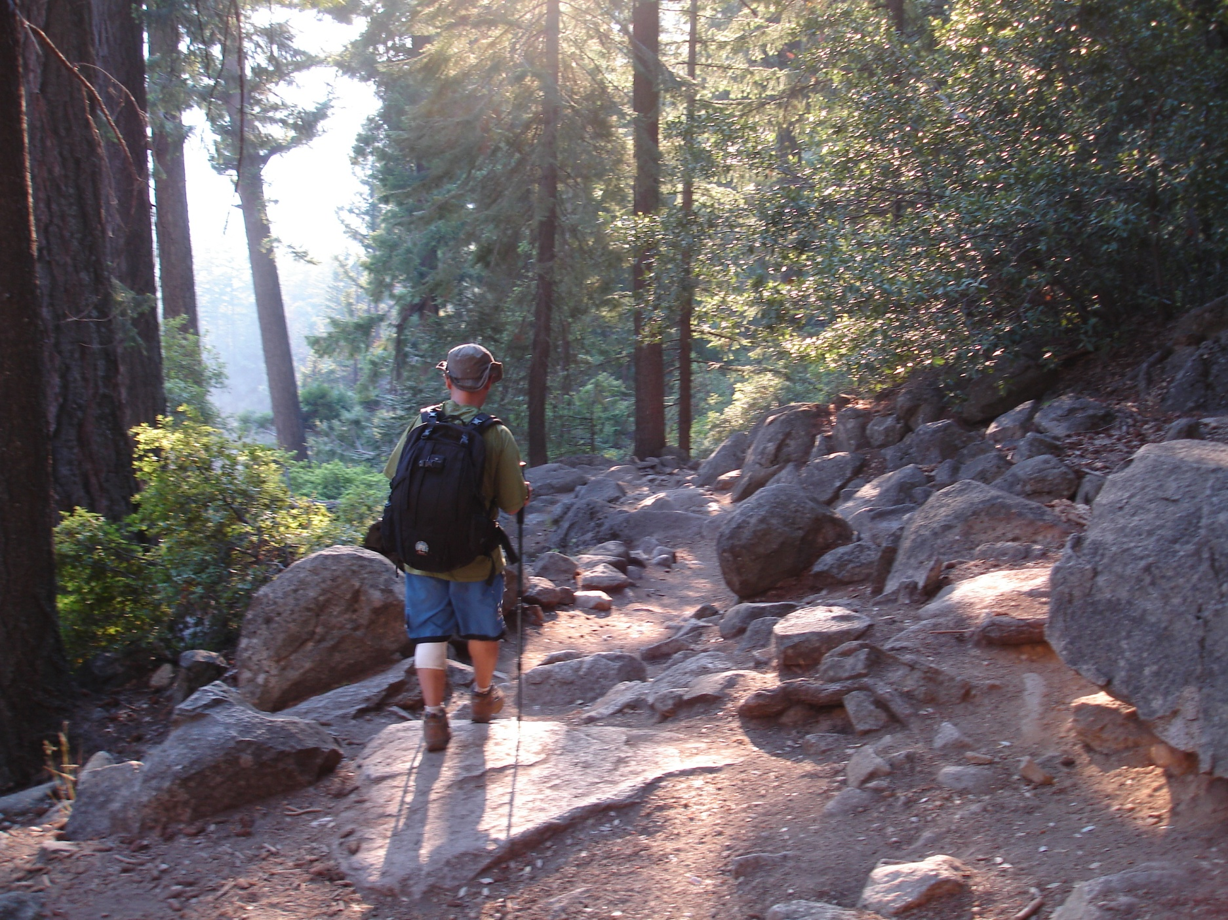

Slide 9
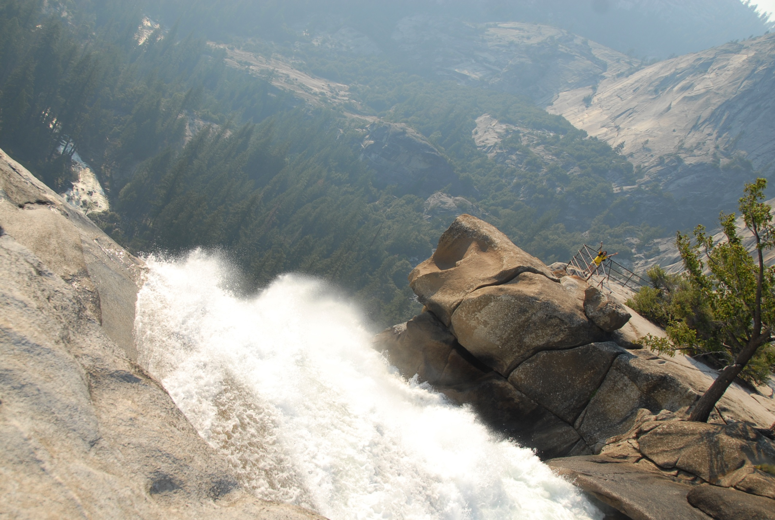

Slide 10
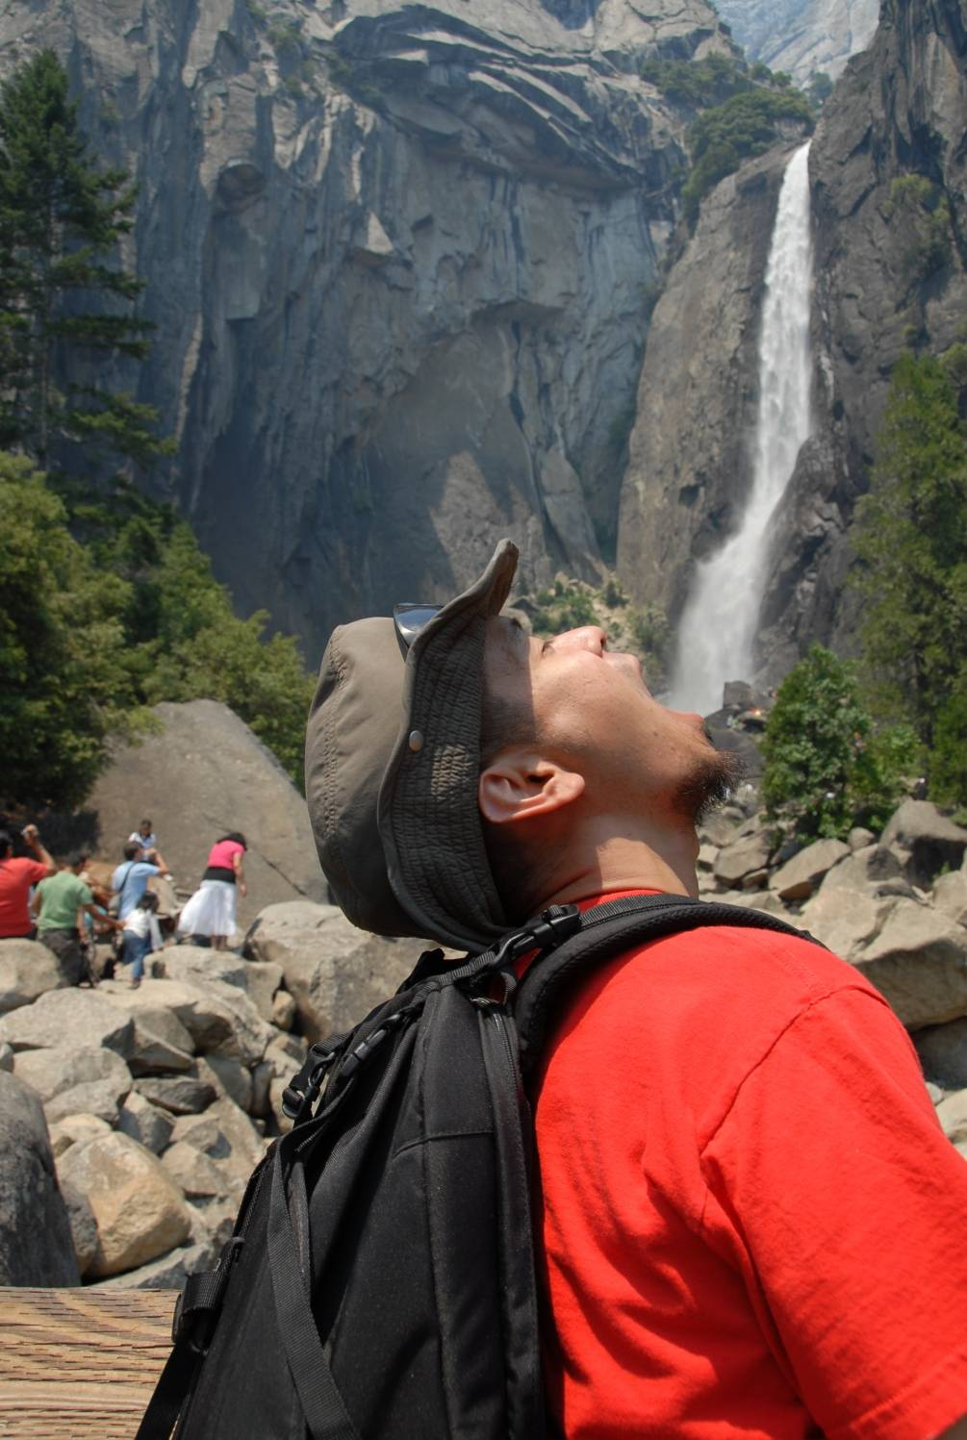

Slide 11
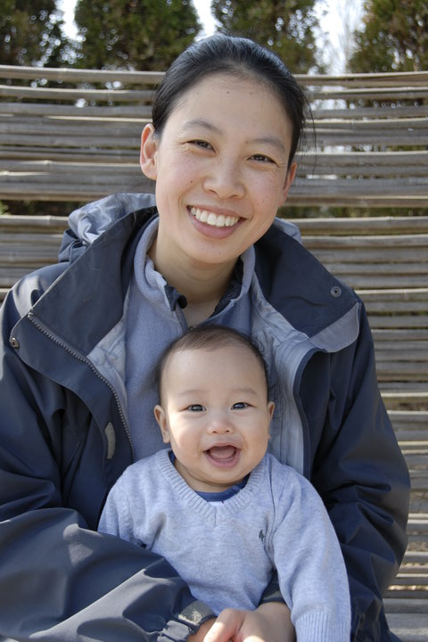

Slide 13
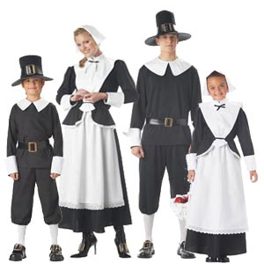

Slide 14
Pilgrimage
  “A Journey with a Spiritual Purpose”
“A Life Journey towards Eternity”

Slide 15
  1) Chose your Destination
Non-Christian ... your destination is towards Death
A Seeker ... your destination is towards the Cross
A Believer ... your destination is towards Heaven
It’s not about a Location but it’s about the Person

Slide 16


Slide 17
  1) Chose your Destination
Proverbs 4:25-26
25 Let your eyes look straight ahead,
fix your gaze directly before you.
26 Make level paths for your feet
and take only ways that are firm.
Proverbs 84
⁵ Blessed are those whose strength is in you,
who have set their hearts on pilgrimage.

Slide 18
  2) Chose your Companions
Proverbs 12:26
A righteous man is cautious in friendship, but the way of the wicked leads them astray.

Slide 19
  3) Chose your Gear
  a) Bible
  b) Relationship with Jesus
  c) Recording Device

Slide 20
  Stay on the Path
Proverbs 4:27
Do not swerve to the right or the left; keep your foot from evil.
Matthew 7:13-14
13"Enter through the narrow gate. For wide is the gate and broad is the road that leads to destruction, and many enter through it. 14But small is the gate and narrow the road that leads to life, and only a few find it.

Slide 21
  We are Not Home Yet
We are not Home yet
Keep on looking ahead
Let your heart not forget
We are not home yet
Steve Cutis Chapman

Slide 22
A Fugitive is one who is
running from home
A Vagabond is one
who has no home
A Stranger is one
away from home
And a Pilgrim is
on his way home

